Slide 1
Region Processing I
Prof. Eric Miller
elmiller@ece.tufts.edu
Fall 2009
EN 74-ECE Image Processing
Lecture 5-<number>

Slide 2
Overview
Many processing methods depend not just on the pixel being processed, but also it’s neighbors
  Removing noise
  Finding interesting features (edges, eyes, tumors, trucks, …)
Region processing can take many forms.
Here we concentrate on one type of method
  Pixel value = weighted average of neighbors
Very, very common and powerful processing method capable of doing all sorts of things
Later we may examine others options
  Pixel value = median of neighbors
Fall 2009
EN 74-ECE Image Processing
Lecture 5-<number>

Slide 3



Start with 1D example
x[n]
Recipe in words:
Output sample at time n is
2 x input sample at time n-1 +
1 x input sample at time n -
2 x input sample at time n+1
3
2
1
1
1
4
7
1
2
3
5
6
-1
2
1
-2
-3
y[n]
Recipe in math:
3
4
System
Fall 2009
EN 74-ECE Image Processing
Lecture 5-<number>

Slide 4

Start with 1D example
x[n]
Recipe in words:
Output sample at time n is
2 x input sample at time n-1 +
1 x input sample at time n -
2 x input sample at time n+1
3
2
1
1
1
4
7
1
2
3
5
6
-1
2
1
-2
-3
y[n]
Recipe in math:
3
5
Note that we are basically “sliding” the sequence [2 1 -2] over x and doing the multiply-and-sum at each step
4
-3
Fall 2009
EN 74-ECE Image Processing
Lecture 5-<number>

Slide 5

Start with 1D example
x[n]
Recipe in words:
Output sample at time n is
2 x input sample at time n-1 +
1 x input sample at time n -
2 x input sample at time n+1
3
2
1
1
1
4
7
1
2
3
5
6
-1
-3
2
1
-2
y[n]
Recipe in math:
9
3
5
Note that we are basically “sliding” the sequence [2 1 -2] over x and doing the multiply-and-sum at each step
4
6
-3
Fall 2009
EN 74-ECE Image Processing
Lecture 5-<number>

Slide 6


Start with 1D example
x[n]
Recipe in math:
3
2
1
1
1
4
7
1
2
3
5
6
What happens at the end?
We need a value for x[8] but there is none
In this class we handle the edge effect by replacing all unspecified values by 0
Other options?
-1
-3
2
1
-2
y[n]
9
3
5
4
6
-3
Fall 2009
EN 74-ECE Image Processing
Lecture 5-<number>

Slide 7
Observations
What this operation “does” is defined entirely by the choice of the weights:
2, 1, -2
The weights are called a “filter” and the operation is call “filtering” the data
The filter is written as its own discrete signal h[n]
Note that we have reversed the order of the weights. Makes equation on the next slide easier.
h[n]
2
1
-1
0
1
-2
h[-1]=-2 h[0]=1 h[1]=2
Fall 2009
EN 74-ECE Image Processing
Lecture 5-<number>

Slide 8
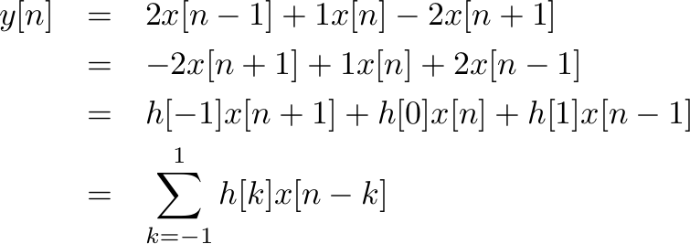
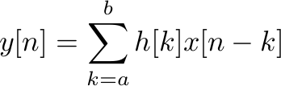
Drum role please: Convolution!
With h[n] defined in this way we rewrite the recipe*
More generally, if h[n] starts at n=a and ends at n=b
* With the understanding that we substitute zero for those values of x we do not have at the ends
Fall 2009
EN 74-ECE Image Processing
Lecture 5-<number>

Slide 9
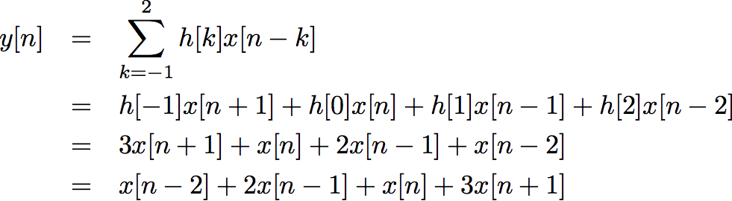
Another toy example
x[n]
h[n]
3
3
2
2
1
1
0
1
2
3
4
-1
0
1
2
What values for n do we get nonzero y?
Fall 2009
EN 74-ECE Image Processing
Lecture 5-<number>

Slide 10
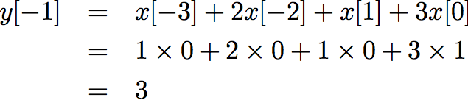
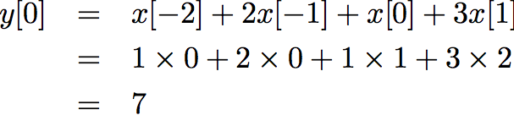
Toy(cont)
n=-1
_x0010_n =0
x[n]
x[n]
3
3
2
2
1
1
0
1
2
3
4
0
1
2
3
4
1
2
1
3
1
2
1
3
Fall 2009
EN 74-ECE Image Processing
Lecture 5-<number>

Slide 11
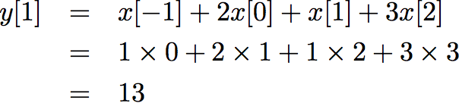
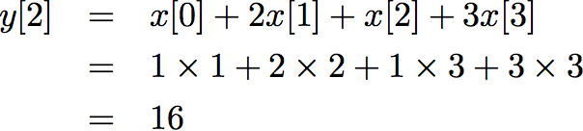
Toy(cont)
n = 1
_x0010_n = 2
x[n]
x[n]
3
3
2
2
1
1
0
1
2
3
4
0
1
2
3
4
1
2
1
3
1
2
1
3
Fall 2009
EN 74-ECE Image Processing
Lecture 5-<number>

Slide 12
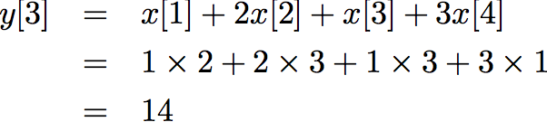
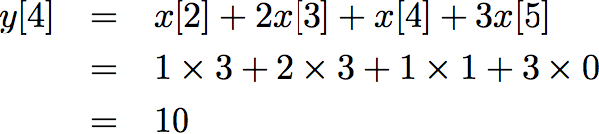
Toy(cont)
n = 3
_x0010_n = 4
x[n]
x[n]
3
3
2
2
1
1
0
1
2
3
4
0
1
2
3
4
1
2
1
3
1
2
1
3
Fall 2009
EN 74-ECE Image Processing
Lecture 5-<number>

Slide 13
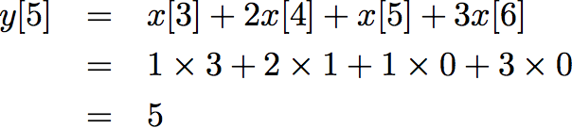
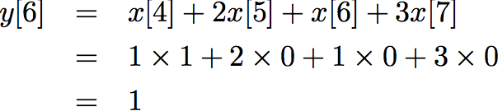
Toy(cont)
n = 5
_x0010_n = 6
x[n]
x[n]
3
3
2
2
1
1
0
1
2
3
4
0
1
2
3
4
1
2
1
3
1
2
1
3
Fall 2009
EN 74-ECE Image Processing
Lecture 5-<number>

Slide 14
Toy Summary
x[n]
h[n]
3
3
y[n]
2
2
1
1
0
1
2
3
4
-1
0
1
2
y[n]={3,7,13,16,14,10,5,1}
Observations
x[n] will always start at 0 in this class (or 1 in Matlab)
h[n] will start at some negative index
In this case
  Full convolution starts at -1 and ends at 7.
  Length = 8
Generally for signal x starting at 0
  Full convolution starts at n = leftmost index of h
  Length of y = length of x + length of h - 1
We will only be concerned with output between n=0 and n = end of x
Fall 2009
EN 74-ECE Image Processing
Lecture 5-<number>

Slide 15
A System that Does Something_x0010_
Think of a system that averages the current sample with it’s neighbor to its left and neighbor to it’s right
For example
Fall 2009
EN 74-ECE Image Processing
Lecture 5-<number>

Slide 16
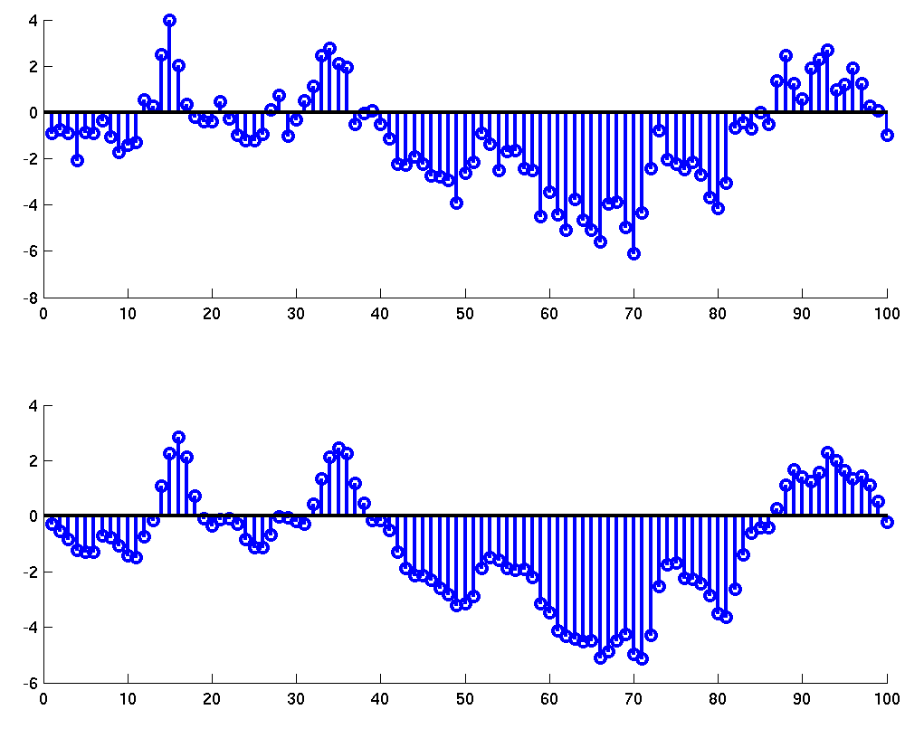
What does this system do?
It replaces x(n) by the average of x(n), x(n-1) and x(n-2)
Generally, averaging things tends to smooth them out
Fall 2009
EN 74-ECE Image Processing
Lecture 5-<number>

Slide 17
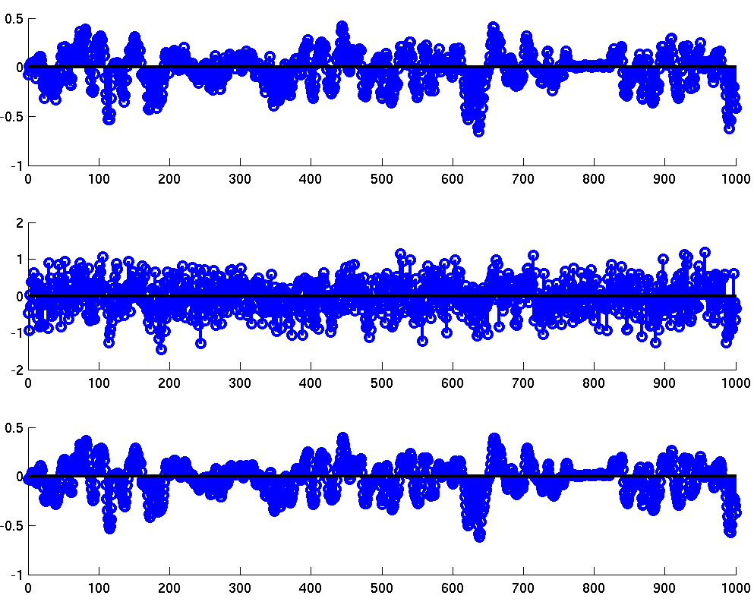
A More Interesting Example
Fall 2009
EN 74-ECE Image Processing
Lecture 5-<number>

